Slide 1
Breast Imaging
An overview for the medical student

Slide 2
Outline
Facts
Anatomy
Imaging modalities and technique
Screening
BIRADS and Breast Density
Diagnostic imaging
Biopsy
Breast disease in the Male population
Cases

Slide 3
Breast Cancer Facts
Most frequent cancer in U.S. women (excluding skin cancer)
1 in 8 women in the U.S. will be diagnosed with breast cancer during their lifetime
2nd highest cause of cancer deaths in women
  Lung is the 1st highest

Slide 4
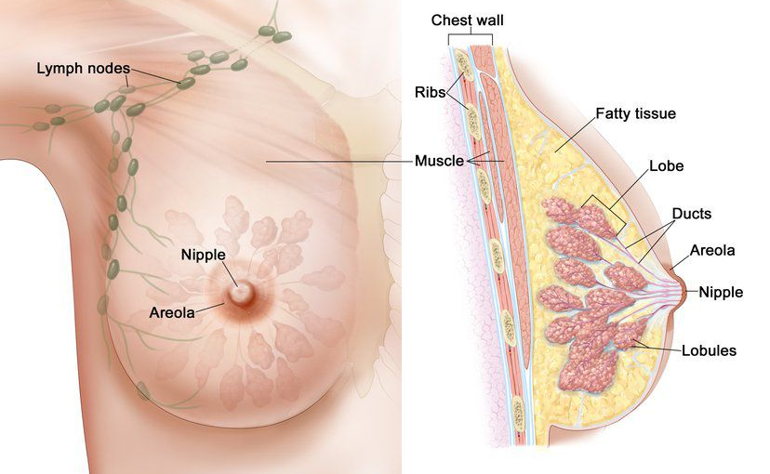
Anatomy
Image courtesy of National Breast Cancer Foundation

Slide 5
Imaging modalities and technique
The most common modalities to image the breast include
  Mammography
  Ultrasound
  MRI
Additional modalities not discussed in detail today
  PET/CT

Slide 6
Mammography
Most common screening and diagnostic tool
Get craniocaudal (CC) and mediolateral oblique (MLO) views of each breast.
  This allows the most tissue to imaged
3D tomosynthesis can be applied
  Multiple images obtained through different parts of the breast allowing the radiologist to “scroll” through the breast, emphasizing masses and architectural distortion not easily detected with a conventional 2D approach
  Most beneficial for women with dense breast tissue
  Fewer unnecessary biopsies and decreases recall rates

Slide 7
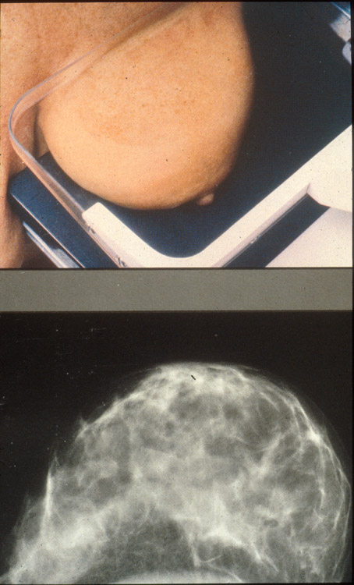
CC
lateral
medial

Slide 8
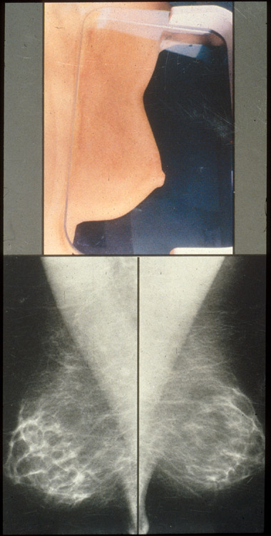
MLO
superior (head)
Inferior (feet)
Notes:
MLO has most breast tissue

Slide 9
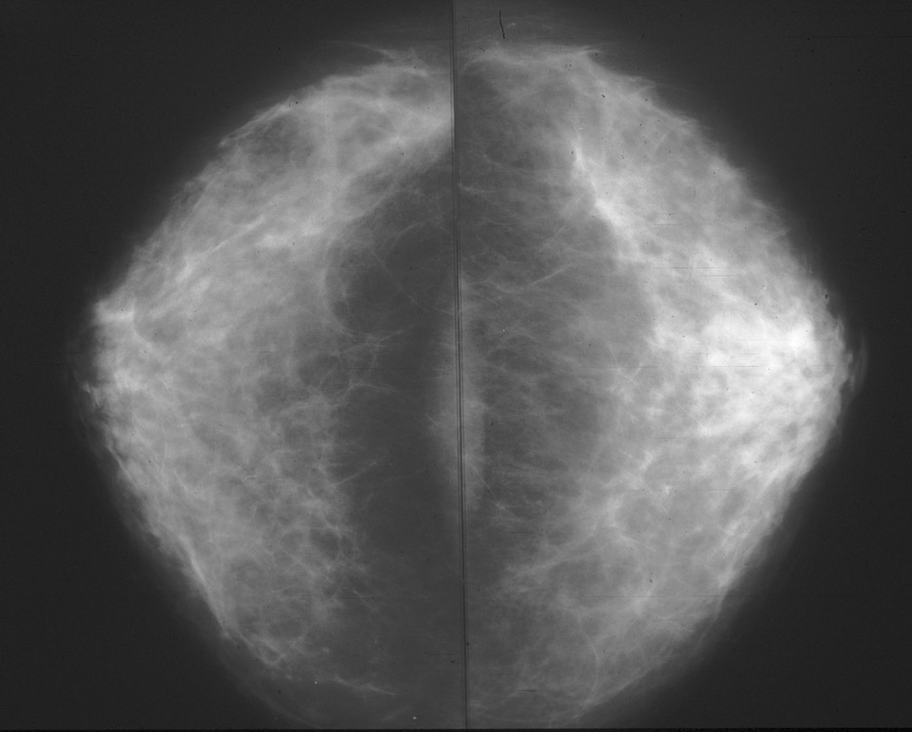
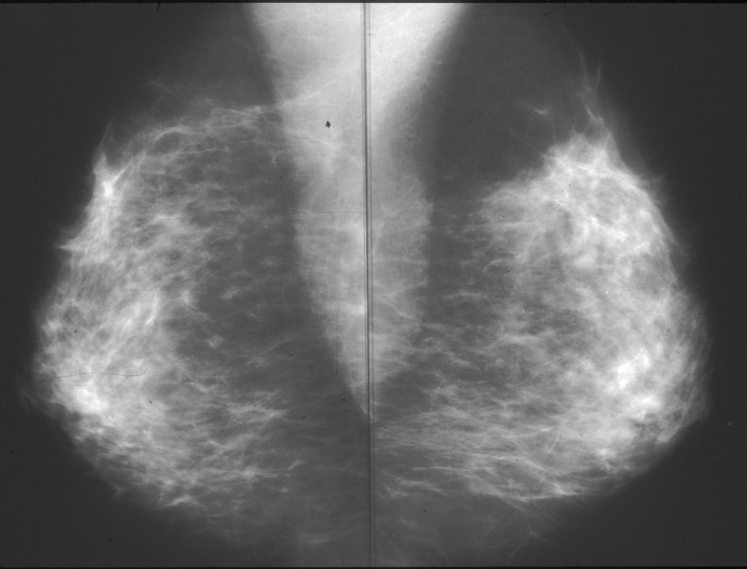
CC, MLO
RMLO
LMLO
RCC
LCC

Slide 10
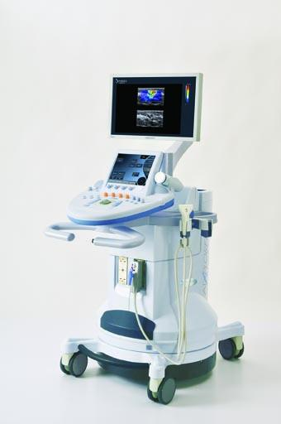
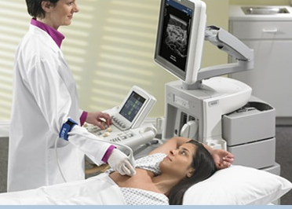
Ultrasound
Excellent diagnostic tool which requires no radiation, is noninvasive, and can be performed quickly at same day appointments
Complements mammography, but should not replace mammography as the primary screening modality
  Characterization of Palpable Abnormality
  Characterization of Masses Detected Mammographically
  Evaluate Areas of Focal Pain

Slide 11
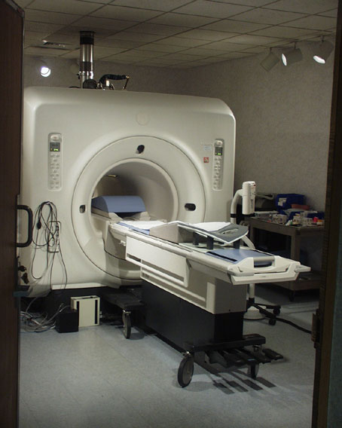
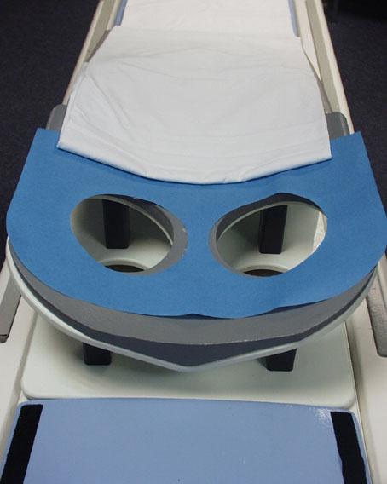
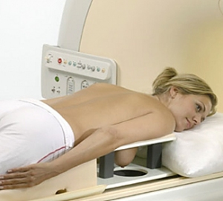
Breast MRI

Slide 12
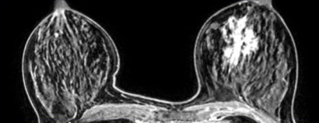
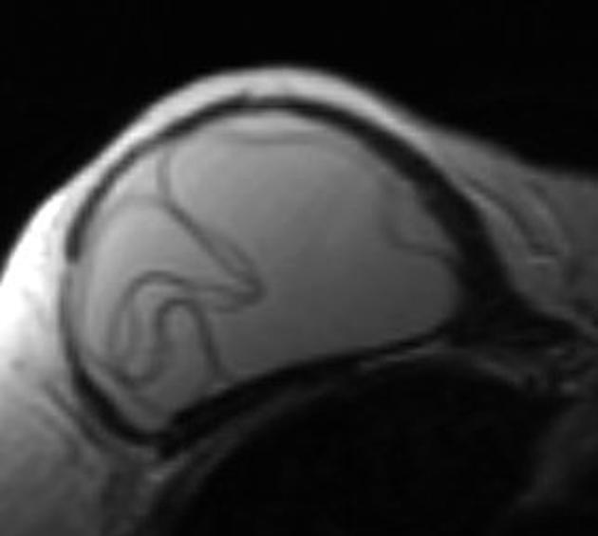
MRI
MRI is more sensitive than mammograms and ultrasound, but not as specific
Indications
  Evaluate for additional sites of disease (ipsilateral extent of disease or contralateral) in cases of biopsy proven malignancy
  Evaluating integrity of breast implants
  Screening in high risk populations - >20% lifetime risk of breast cancer (see screening)
MRI limitations:
  Gadolinium contrast allergy
  Difficult prone positioning, which may not be tolerable for all patients
  Pacemakers, spinal stimulators, etc, which may not be MRI compatible
Left breast invasive ductal carcinoma
Intracapsular implant rupture
“Linguine sign”
Images courtesy of Radiology Assistant and Radiopeadia

Slide 13


General Screening Guidelines
General Public guidelines (average risk)
  Primary modality is mammography
  The American College of Radiology and Society of Breast Imaging recommend:
    Starting at age 40
    Continue to perform annually
    Screening can be stopped on a case by case basis per individual patient’s health status
High risk populations should consider adjunctive MRI
      Additional organizations have controversial guidelines suggesting starting at 45 to 50, follow up every 1-2 years, and potentially stop screening by 74 years of age (USPSTF, ACOG, and ACS)

Slide 14
MRI screening
Ideal for annual screening in high risk populations which include:
  Calculated lifetime risk of 20% or more
    Anyone with two 1st degree relatives (sister, mother, daughter) diagnosed with breast cancer
  Carries a BRCA mutation
  1st degree relative of a BRCA carrier, but untested
  Radiation therapy to the chest received between the age 10 and 30 years, at least 8 years after completing radiation
  Genetic syndrome patients and their 1st degree relatives including
    Li-Fraumeni
    Cowden
    Bannayan-Riley-Ruvalcaba
  MRI is NOT currently recommended purely on the basis of breast density. Thus, dense breasts ≠ MRI for screening.
  Women at 15-20% lifetime risk should discuss yearly MRI with their physician
  2. American Cancer Society Guidelines https://doi.org/10.3322/canjclin.57.2.75

Slide 15
BIRADS
Acronym for: “Breast Imaging-Reporting and Data System”
Widely accepted classification system and reporting method which assesses risk and promotes consistency and clear communication.
BIRADS 0: incomplete; further imaging or evaluation is needed
  also includes when previous/outside imaging has been requested
BIRADS 1: negative
BIRADS 2: benign
BIRADS 3: probably benign
BIRADS 4: suspicious abnormality
BIRADS 5: highly suggestive of malignancy
BIRADS 6: known biopsy proven malignancy

Slide 16
BIRADS |  | Likelihood of cancer | Recommendation
BIRADS 0 | Incomplete | -n/a | Need priors, recall
BIRADS 1 | Negative | 0 | Annual Mammogram
BIRADS 2 | Benign | 0 | Annual Mammogram
BIRADS 3 | Probably Benign | >0% but <2% | Short term 6 mo f/u
BIRADS 4 | Suspicious abnormality | 2%-95% 4a. Low suspicion >2% but <10% 4b. Moderate suspicion >10% but <50% 4c. High suspicion >50% but <95% | Biopsy
BIRADS 5 | Highly suggestive of malignancy | >95% | Biopsy
BIRADS 6 | Known biopsy proven malignancy | n/a | n/a

Slide 17
Breast Density
Required in mammogram report
3D tomosynthesis helpful for category B through D
A – Almost entirely fatty
B – Scattered fibroglandular densities
C – Heterogeneously dense
D – Extremely dense

Slide 18
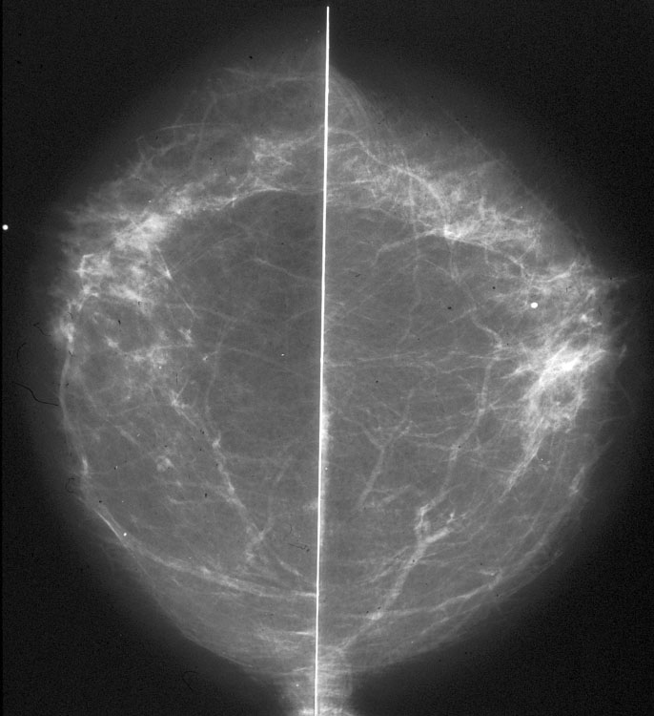
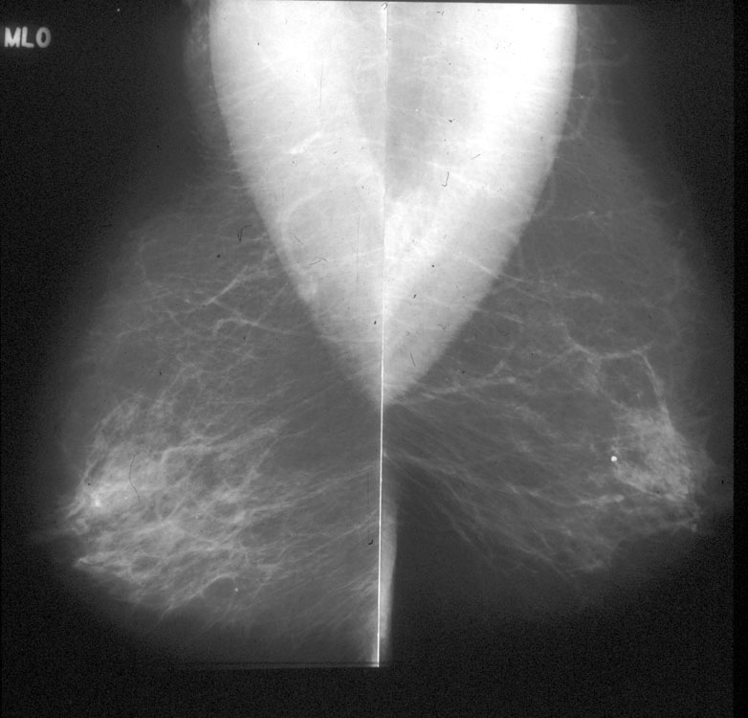
A – Almost entirely fatty

Slide 19
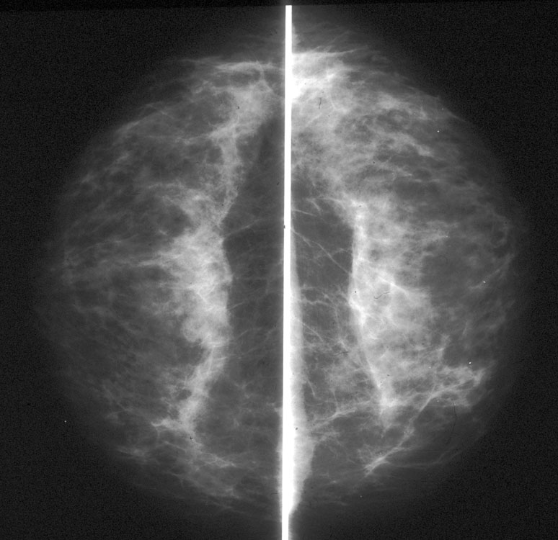
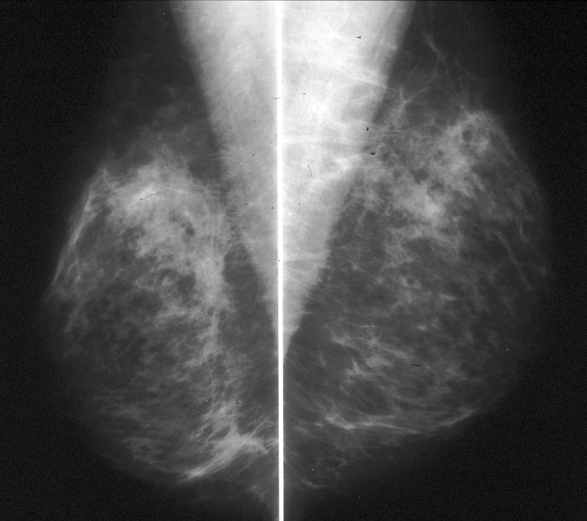
B – Scattered fibroglandular densities

Slide 20
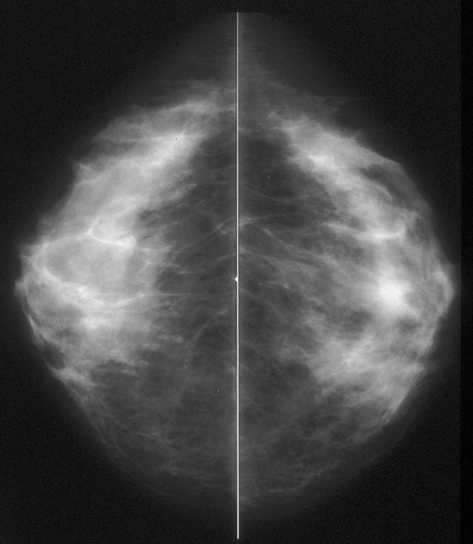
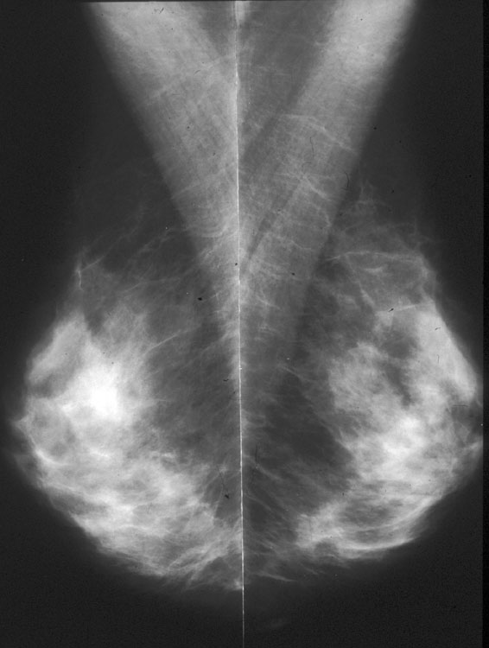
C – Heterogeneously Dense

Slide 21
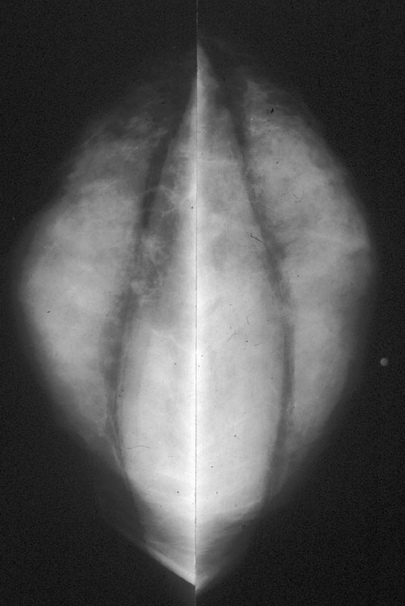
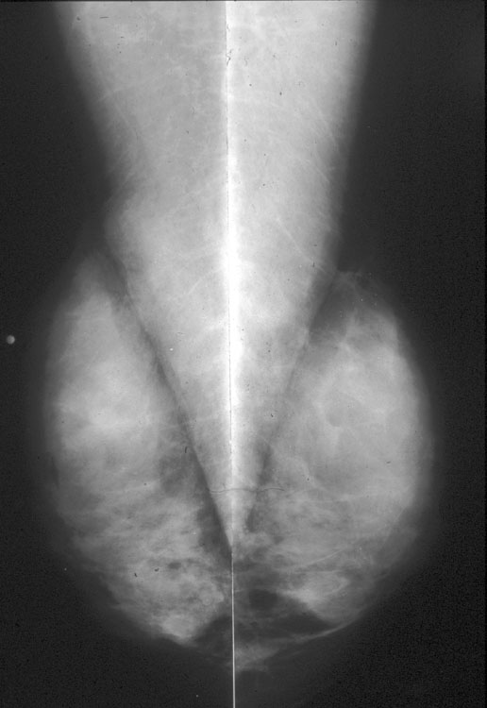
D – Extremely dense

Slide 22
Diagnostic imaging
  Something was found on screening mammogram
    New or enlarging mass, suspicious calcifications, new asymmetries or architectural distortion
  Patient has focal pain
  Patient has a palpable mass
    Under 30 years of age? → start with ultrasound
    Over 30?
      Not breastfeeding → start with mammogram
      Breastfeeding → ultrasound
  If they are status post lumpectomy, their yearly “screening” will be treated as a diagnostic case for at least 7 years
    This allows for same day additional imaging with mammogram or ultrasound, as well as a spot magnification view over the lumpectomy site.

Slide 23
Breast Biopsy
Outpatient procedures using local anesthetic
Once a suspicious area has been identified the following modalities are available to obtain tissue samples
  Ultrasound
    Most common for masses and lymph nodes
  Stereotactic
    Best for suspicious calcifications, areas of architectural distortion, and very small masses
    Can be done in 2D or 3D
    Can be done with patient sitting upright or laying prone
  MRI
    Less frequent, but sometimes necessary for findings without reliable sonographic or mammographic correlates
    Patient needs to be able to tolerate laying prone and still for long periods of time

Slide 24
Breast disease in the male population
Gynecomastia
  Most common complaint
  Typically painful and usually bilateral
  Mammogram +/- US can further assess
  May point to hormonal imbalances or side effects to drug
  Some cases may require surgical excision for cosmetic/symptom relief
Breast Cancer
  “Male breast cancer makes up less than 1% of all cancers in men and less than 1% of all breast cancers in the United States”⁶
  Detection is usually delayed, thus typically presents at a later stage
  Like in women, genetic mutations like BRCA significantly increase the risk of breast cancer in men and routine screening can be considered

Slide 25
Cases

Slide 26
Case 1
A 35 yo female with cyclical unilateral lower axillary fullness and tenderness without focal palpable mass.
What mammographic finding would best explain her symptoms?
High density lymph nodes
Adenopathy
Irregular mass
Axillary breast tissue

Slide 27
Case 1
A 35 yo female with cyclical unilateral lower axillary fullness and tenderness without focal palpable mass.
What mammographic finding would best explain her symptoms?
High density lymph nodes
Adenopathy
Irregular mass
Axillary breast tissue
  Usually asymptomatic, but can present with cyclical pain and fullness related to menses.

Slide 28
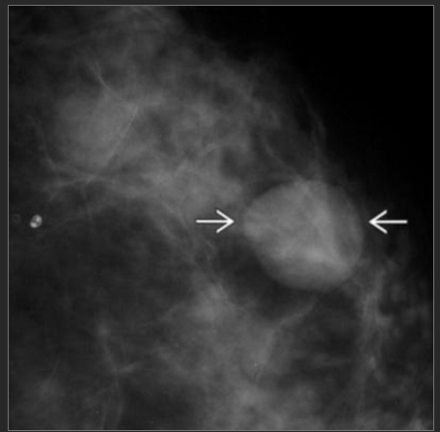
Case 2
45 y/o F with new mass on annual screening mammogram.
What is the next step?
6 mo. f/u diagnostic mammogram
Ultrasound for further evaluation
Stereotactic Biopsy
MR guided Biopsy
Return to screening

Slide 29
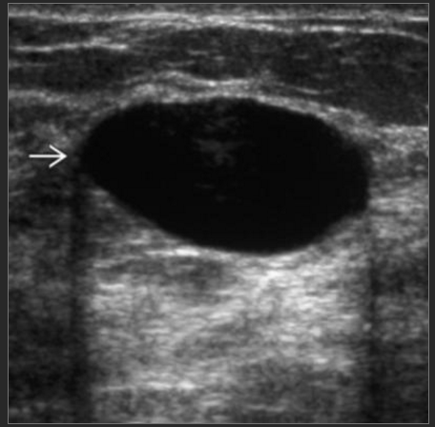
B. Ultrasound for further evaluation
What is the diagnosis?
Simple cyst
Fibroadenoma
Cancer
Papilloma
Notes:
Oval, circumscribed anechoic mass with posterior acoustic enhancement.
A. Simple cyst

Slide 30
A. Simple cyst
What next?
Biopsy
Do nothing. Return to screening population.
If symptomatic, aspirate. If asymptomatic, do nothing and return to screening.
Surgical consult for surgical excision.

Slide 31
C. If symptomatic, aspirate. If asymptomatic, do nothing and return to screening.
Patient was symptomatic. Cyst aspirated with return of yellow/green fluid. Cyst collapsed/disappeared. What next?
Discard fluid. Return to screening.
Send fluid for cytology.
Biopsy
Answer: A. Discard fluid. Return to screening.
  Only sanguineous fluid is worrisome and sent for cytology.
  Or if cyst cannot be completely aspirated/has solid component.

Slide 32
Case 3
A PET/CT was performed and an FDG-avid breast mass was identified.
Which of the following is NOT an indication for PET/CT in breast imaging?
Screening
Staging
Restaging
Response to therapy

Slide 33
Case 3
A PET/CT was performed and an FDG-avid breast mass was identified.
Which of the following is NOT an indication for PET/CT in breast imaging?
Screening
  Mammography is the gold standard for screening.
  High risk patient? – add Breast MRI.
Staging
Restaging
Response to therapy

Slide 34
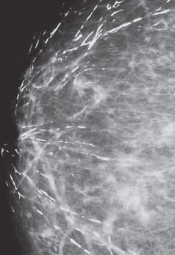
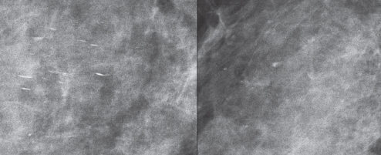
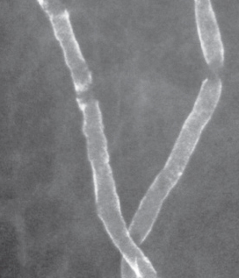
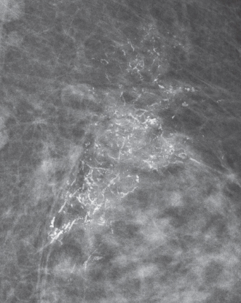
Case 4
Which of the following calcifications requires biopsy (BIRADS 4)?
B
Lateral
CC
A
C
D

Slide 35
Case 4
Which of the following calcifications requires biopsy (BIRADS 4)?
A. Secretory
Diffuse, large rod-like
Projects towards nipple
Lateral
CC
B. Milk of Calcium. Note change in shape with positioning, layering on true lateral
C. Vascular
“train tracks”
D. Suspicious
Fine, pleomorphic
Segmental distribution

Slide 36
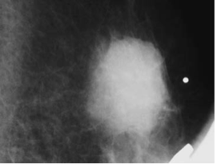
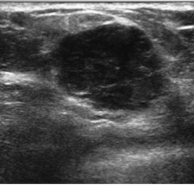
Case 5
52 yo female, asymptomatic. Recall from screening mammogram.
Spot magnification
Ultrasound
Cyst
Normal fibroglandular tissue
Invasive breast cancer
Normal lymph node

Slide 37
Case 5
52 yo female, asymptomatic. Recall from screening mammogram.
Cyst
Normal fibroglandular tissue
Invasive breast cancer
Normal lymph node
Spot magnification
Spot magnification demonstrates mass with:
Oval shape
Indistinct margin
High density
On same day ultrasound:
Oval, angular/microlobulated margins
Heterogeneously hypoechoic
Ultrasound

Slide 38
Types of Invasive Breast Cancer
Most common
  Ductal
    Invasive ductal NOS
    Tubular
    Papillary
    Mucinous
    Medullary
  Lobular
    Invasive lobular
Less common
  Stromal
    Phyllodes
    Angiosarcoma
    Adenoid cystic carcinoma
    Osteosarcoma
  Metastatic Disease
  Other
    Leukemia
    Rhabdomyosarcoma

Slide 39
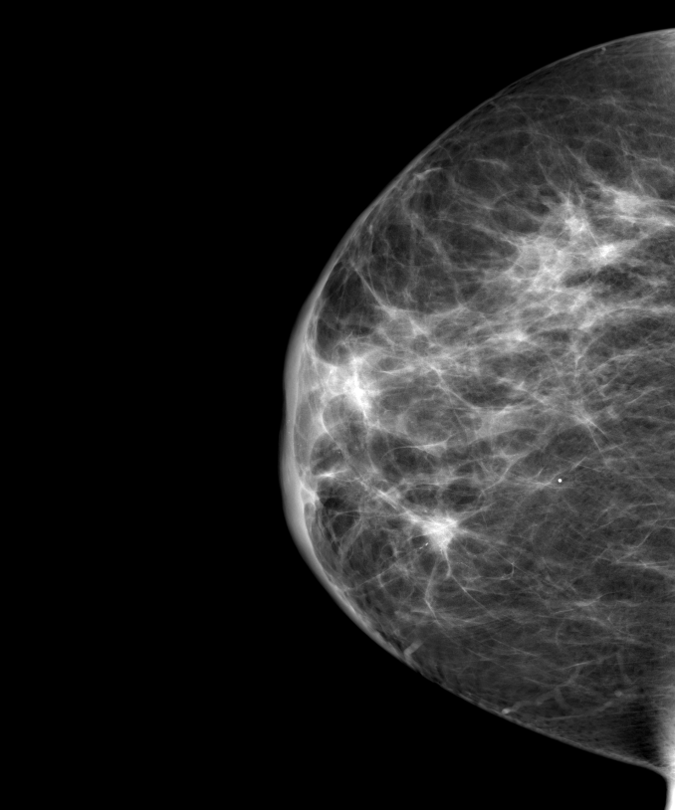
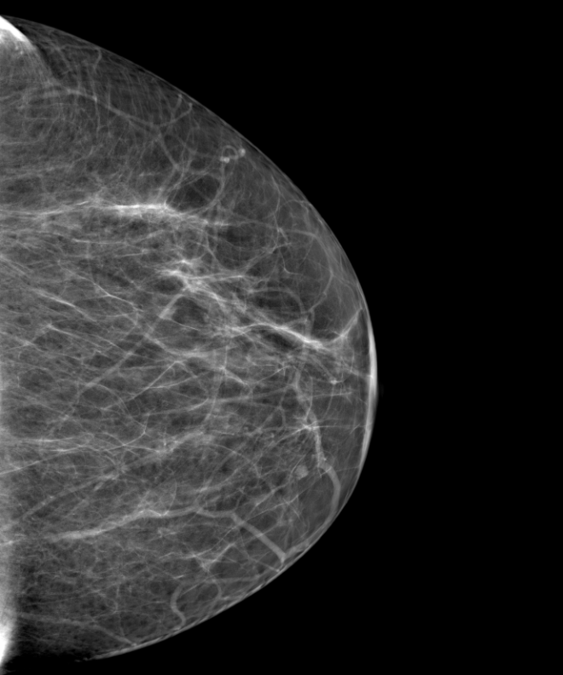
Case 6
64 y/o F with diffuse asymmetric right breast skin thickening, developed within the last several weeks.
RCC
LCC
Skin thickening secondary to edema from systemic cause (heart failure, other volume overload state)
Mastitis versus inflammatory breast cancer
Normal finding due to aging
Mondor Disease (thrombophlebitis)

Slide 40
Case 6
64 y/o F with diffuse asymmetric right breast skin thickening, developed within the last several weeks.
RCC
LCC
Skin thickening secondary to edema from systemic cause (heart failure, other volume overload state)
Mastitis versus inflammatory breast cancer
Normal finding due to aging
Mondor Disease (thrombophlebitis)
Notes:
Blue arrows – skin thickening
Yellow arrows - asymmetric tissue when compared to the left breast.

Slide 41
B. Mastitis versus Inflammatory Breast Cancer
Mastitis can present at any age, but is more common in breast feeding patients
  Recommend continued breast feeding
  Can trial a course of antibiotics, but if symptoms don’t resolve further evaluation is required
    Ultrasound to exclude abscess
    Skin punch biopsy to exclude inflammatory breast cancer
Inflammatory Breast Cancer
  Additional presentation of invasive ductal
  May initially “respond” to ABx but will not resolve
  Usually does not have a distinct mass on mammogram
  Higher risk of metastasis: check for abnormal lymph nodes

Slide 42
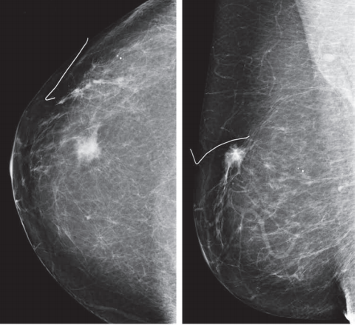
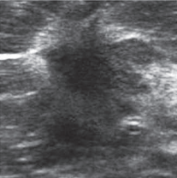
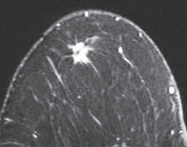
Case 7
55 y/o F. Asymptomatic. Recall from screening mammogram.
Normal lymph node
Lipoma
Invasive lobular carcinoma
Simple cyst

Slide 43
Case 7
55 y/o F. Asymptomatic. Recall from screening mammogram.
Normal lymph node
Lipoma
Invasive lobular carcinoma
Simple cyst
Spiculated margins on mammogram, ultrasound, and MRI = WORRISOME
On ultrasound – hypoechoic mass with irregular margins and posterior shadowing
Notes:
C.

Slide 44
Additional pointers to look like a Pro
Send skin lesions to Derm, not Mammo (A zit on the breast is still a zit)
No one recommends mammograms prior to age 25, even in very high risk patients
Be clear on what constitutes a “STRONG” family history: first degree relative(s) prior to menopause
Bilateral or diffuse breast tenderness is not an indication for diagnostic mammography outside of a routine screening examination if the patient is due for one

Slide 45
Thanks!

Slide 46
References
https://nbcf.org.au/about-national-breast-cancer-foundation/about-breast-cancer/what-you-need-to-know/breast-anatomy-cancer-starts/
Saslow D, Boetes C, Burke W, et al. American Cancer Society Guidelines for Breast Screening with MRI as an Adjunct to Mammography. CA: A Cancer Journal for Clinicians. 2007;57(2):75-89. doi:10.3322/canjclin.57.2.75.
https://www.cdc.gov/cancer/breast/pdf/BreastCancerScreeningGuidelines.pdf
ACR BI-RADS Atlas 5th Edition
http://www.radiologyassistant.nl/en/p53b4082c92130/bi-rads-for-mammography-and-ultrasound-2013.html#in53d4e9a9cf571
Jemal A, Siegel R, Ward E, et al. Cancer statistics, 2008. CA Cancer J Clin. 2008 Mar-Apr; 58(2):71-96.
http://www.radiologyassistant.nl/en/p47a585a7401a9/breast-mri.html
https://radiopaedia.org/articles/breast-implant-rupture?lang=us

