Slide 1
General Surgery Clerkship
Abdominal Imaging Subsection

Slide 2
Surgical Imaging
Imaging used routinely for acute abdomen - acutely ill with either diffuse or localized abdominal pain. May also have fever, leukocytosis, and other lab derangements depending on etiology (e.g. elevated bilirubin, creatinine, lactic acid)
Imaging also used to look for postoperative complications
How to work up with imaging?
  CT is the workhorse of acute surgical imaging
  US for gallbladder pathology, torsion (ovarian and testicular) and transplant evaluation (vascular flow in realtime)
  Plain film may be used to serially follow ileus/SBO or quickly look for free air
  Fluoro for anastomotic leaks, esophageal perforation, identifying site of obstruction, urethral injury, identify if abscess connects to bowel, etc…
  MRI typically not used acutely except appendicitis in pregnant females

Slide 3
Ordering CT
With vs. without contrast
  Contrast almost always helpful in the abdomen due to many closely apposed structures. If renal function is OK and no allergy to iodine, likely should order with contrast
  EXCEPTION is when looking for renal stones. CT stone study = CT abdomen/pelvis without contrast
WITH
WITHOUT

Slide 4
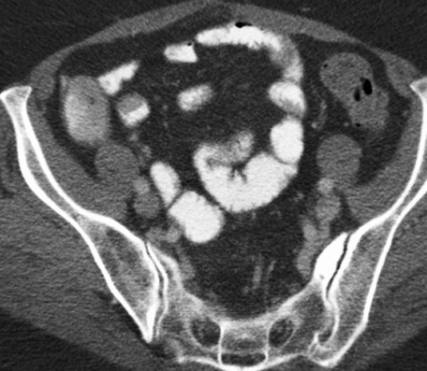
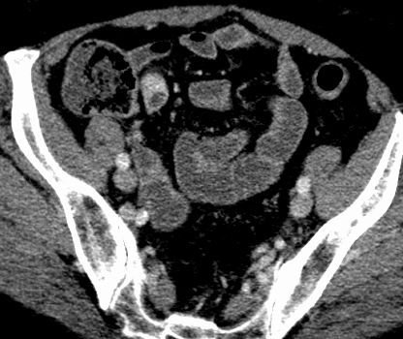
ORAL CONTRAST
Positive contrast = iodinated. Best to identify anastomotic leak. Bad if concern for ischemia, cannot see mucosa.
Negative contrast = water or Volumen. Distends bowel and provides detail of mucosa. Cannot evaluate for leak.
Positive
Negative

Slide 5
Options for IV Contrast
Standard single-phase CT abdomen/pelvis with contrast
  Portal venous phase (70-80 seconds)
  Good for acute abdominal pain, many cancers, infection, bowel obstruction

Slide 6
Bowel ischemia/GI bleeding protocol
1. Noncontrast
2. Arterial phase
3. Portal venous

Slide 7
Trauma protocol
1. Portal venous
2. Nephrographic (2 min delay)

Slide 8
AAA/aortic dissection protocol (can include chest)
1. Noncontrast
2. Arterial
3. 5 min delay

Slide 9
Don’t need to know details, but there are specific protocols for pancreas, liver, kidney, urinary collecting system (most commonly used to evaluate tumors of these organs). Just know they exist!

Slide 10
Case 1
65 year old female with no significant PMH presents to the ED with right upper quadrant pain.
On abdominal exam, she had tenderness in the right upper quadrant of the abdomen. Negative Murphy’s sign on ED examination.
Labs were unremarkable.

Slide 11
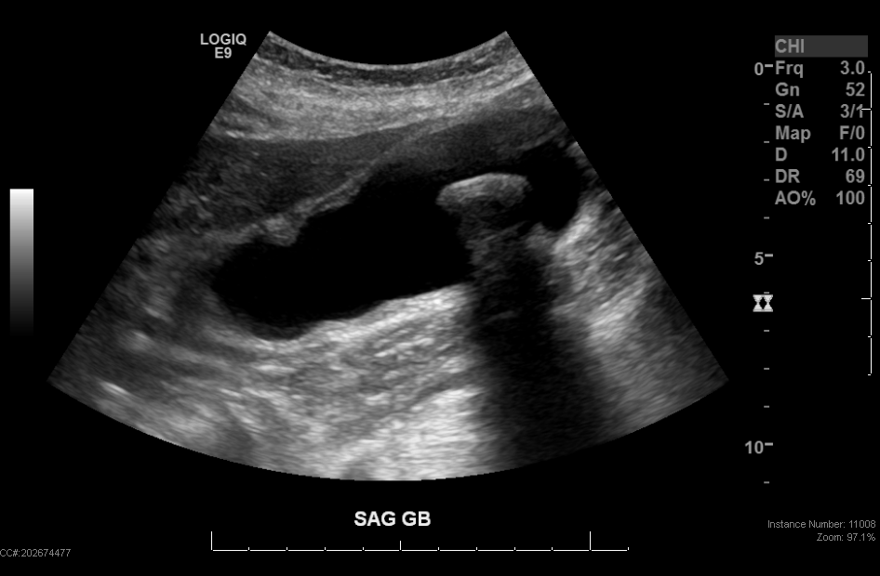
RUQ US

Slide 12
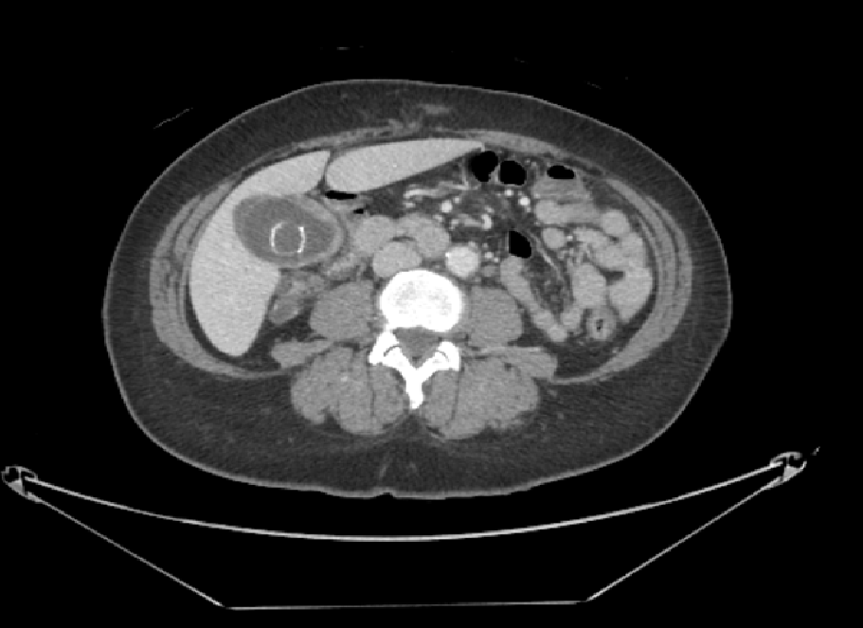
CT Axial

Slide 13
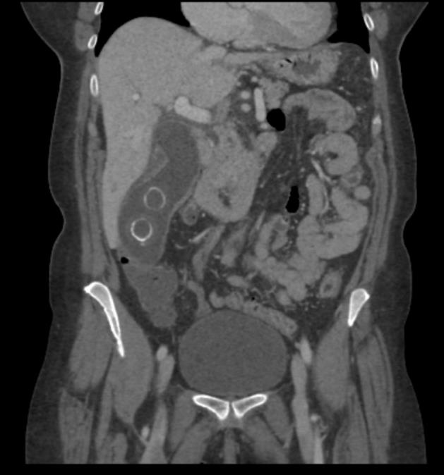
CT Coronal

Slide 14
Diagnosis?

Slide 15
Acute Calculous Cholecystitis
Imaging findings
  US: Sonographic “Murphy’s Sign”, gallstone impaction in gallbladder neck, pericholecystic fluid, gallbladder wall thickening, gallbladder distension
  CT: Gallbladder wall thickening, pericholecystic fat stranding, increased enhancement of the gallbladder wall, gallstones
Complications
  Abscess formation
  Gas in the gallbladder wall or lumen
  Perforation
Acalculous cholecystitis: absence of gallstones, otherwise similar findings as calculous cholecystitis
  Typically occurring in critically ill (biliary stasis) and immunocompromised patients (opportunistic infection)
  Higher risk for complications, due to atypical and insidious presentation.

Slide 16
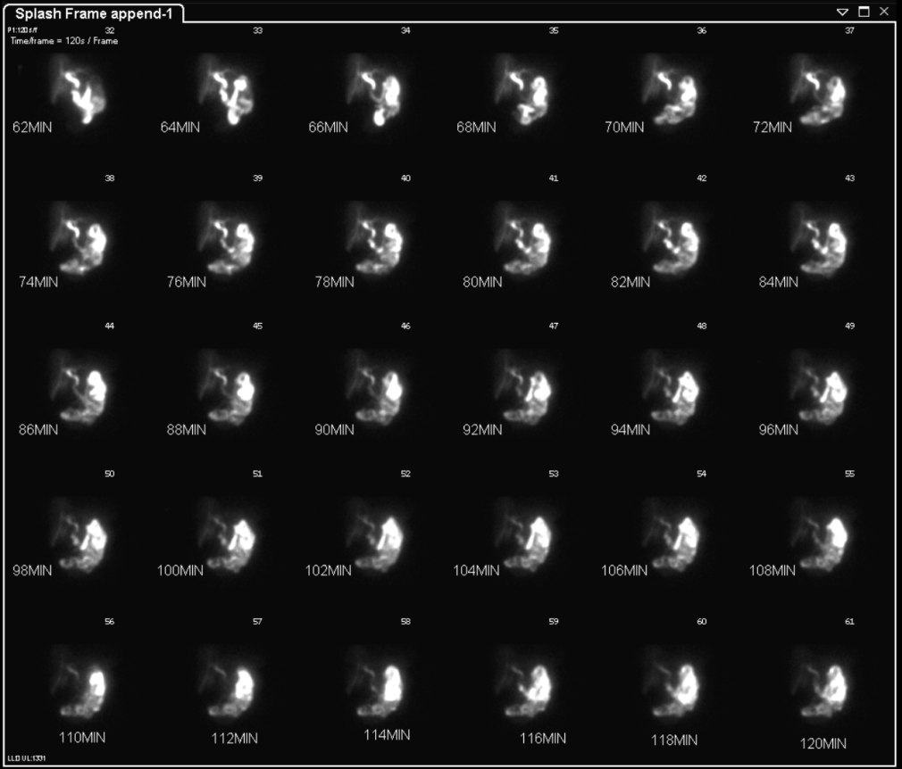
HIDA scan used for equivocal cases

Slide 17
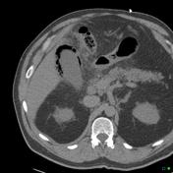
Companion case – emphysematous cholecystitis
Radiopaedia.org

Slide 18
Case 2
59 year old female presents to the ED with vomiting. She has had no flatulence or bowel movement over 3 days. She also has diffuse abdominal pain. No prior history of surgery.
On examination, she has diffuse tenderness with palpation. Negative rebound tenderness.
Labs: mild anemia, otherwise unremarkable.

Slide 19
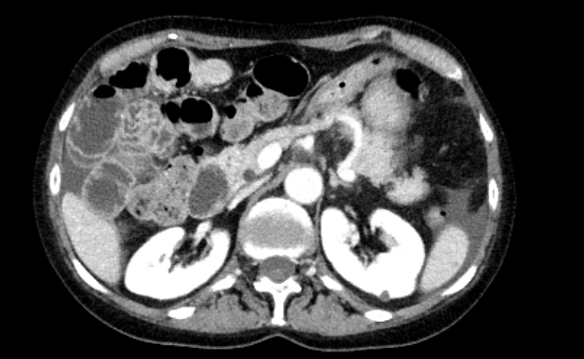
Ct axial

Slide 20
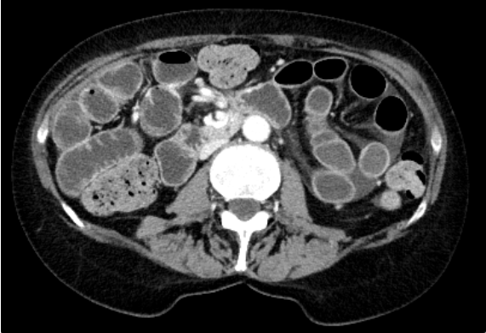
Ct axial 2

Slide 21
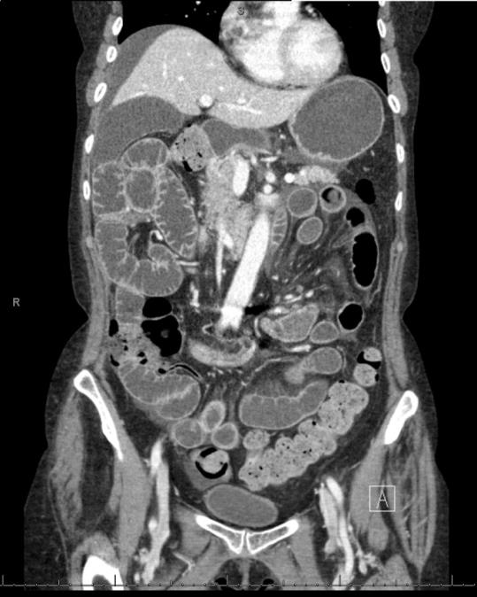
CT coronal

Slide 22
DIAGNOSIS?

Slide 23
Small bowel obstruction (internal hernia)
Imaging findings
  Radiography: dilated sloops of small bowel, air-fluid levels on upright and decubitus radiograph. Not very sensitive or specific.
  CT: dilated loops of small bowel, transition point with decompressed loops of bowel distally.
Etiology: adhesions, hernia (internal or external), malignancy (especially peritoneal carcinomatosis), other inflammatory causes.
Close loop obstruction: obstruction at two different points involving mesentery.
  Often due to twisting of the small bowel with stretched mesenteric vessels towards the site of torsion (swirling mesentery).
Strangulation: imaging findings of decreased or absent bowel wall enhancement.
  Pneumatosis and portal venous gas are grim indicators of bowel necrosis.

Slide 24
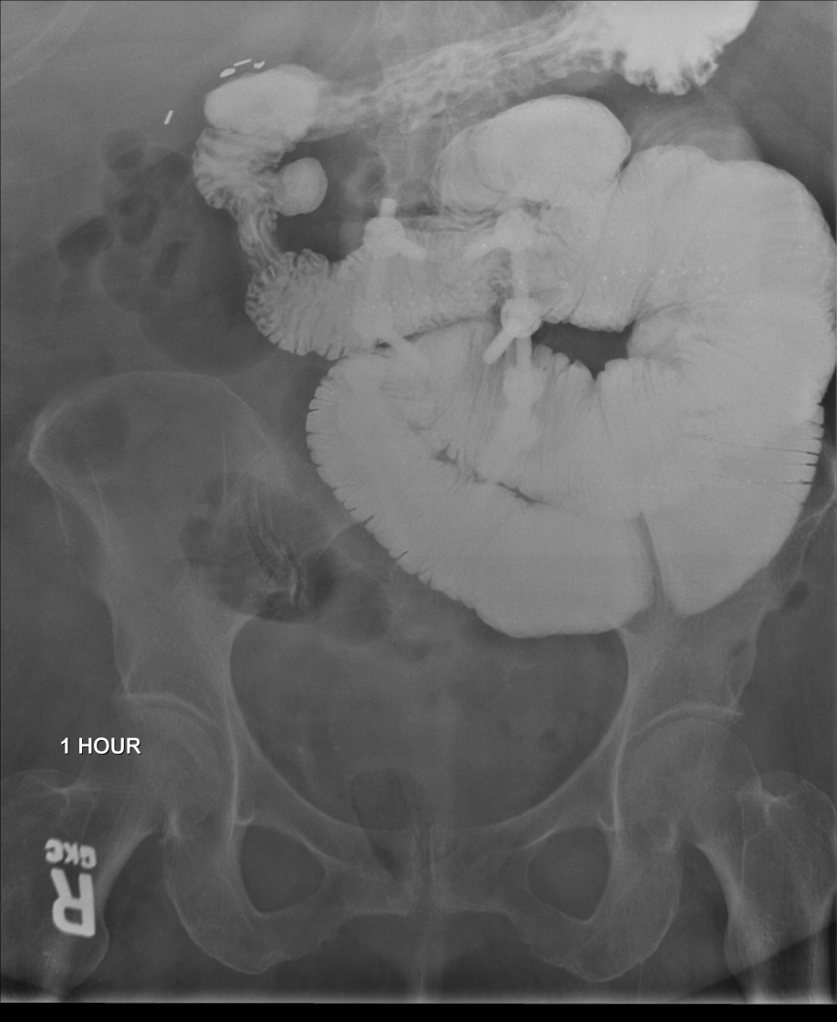
Small bowel follow through can be used if transition point not seen by CT, patient not improving or want to differentiate SBO vs ileus

Slide 25
Case 3
23 year old female presents to the ED after MVA. She is noted to have pelvic fractures on initial trauma CT and is now complaining of hematuria.

Slide 26
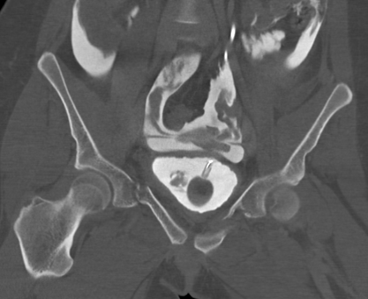
CT cystogram coronal

Slide 27
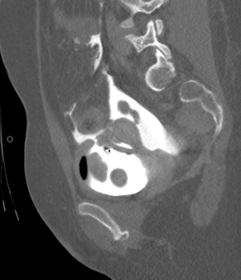
CT cystogram sagittal

Slide 28
DIAGNOSIS?

Slide 29
Intraperitoneal bladder rupture
Imaging findings:
  CT cystogram: contrast instilled into bladder via Foley. If bladder is ruptured, contrast will spill outside of the bladder lumen. Contrast will surround and outline bowel loops (intraperitoneal) or be confined to the prevesical space, producing the classic “molar tooth” appearance (extraperitoneal)
Etiology
  Bladder rupture seen in setting of trauma with pelvic fractures, occasionally spontaneous if there is a predisposing condition
Management
  Intraperitoneal is less common. Injury usually at bladder dome. Typically requires surgical management.
  Extraperitoneal is more common. Injury may be in bladder wall or neck. Typically is conservatively managed.

Slide 30
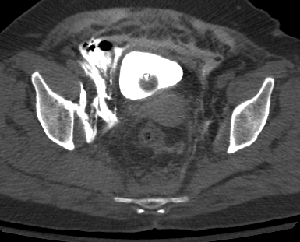
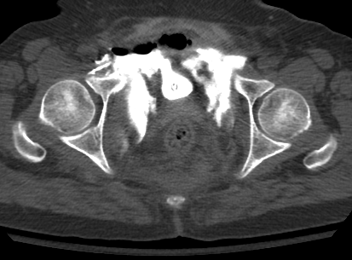
Companion Case – extraperitoneal bladder rupture

Slide 31
CASE 4
20 year old male with acute onset RLQ pain and anorexia, nausea/vomiting
Guarding and rebound tenderness in RLQ on exam
Mild leukocytosis; labs otherwise unremarkable

Slide 32
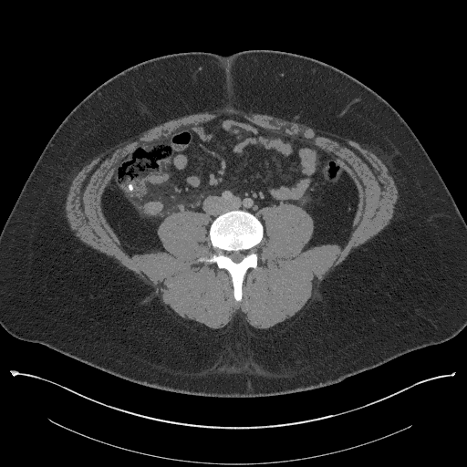
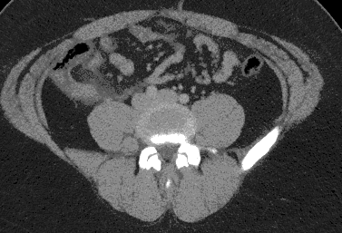
CT axial

Slide 33
DIAGNOSIS?

Slide 34
Acute appendicitis
Imaging findings
  Dilated, hyperenhancing appendix (> 7 mm). If necrotic or perforated, wall may be nonenhancing or have focal discontinuity
  RLQ fat stranding and reactive thickening of peritoneal lining
  +/- appendicolith
  Look for abscess, perforation
  If early appendicitis, imaging changes may only involve tip of appendix
  US can be diagnostic in children and possibly pregnant women, MRI is an alternative in pregnant patients

Slide 35
CASE 5
45 year old male with long history of burning epigastric pain, especially after eating. Now presenting to ED with acute onset markedly worsened pain.
Appears in distress on exam, significant epigastric tenderness and guarding

Slide 36
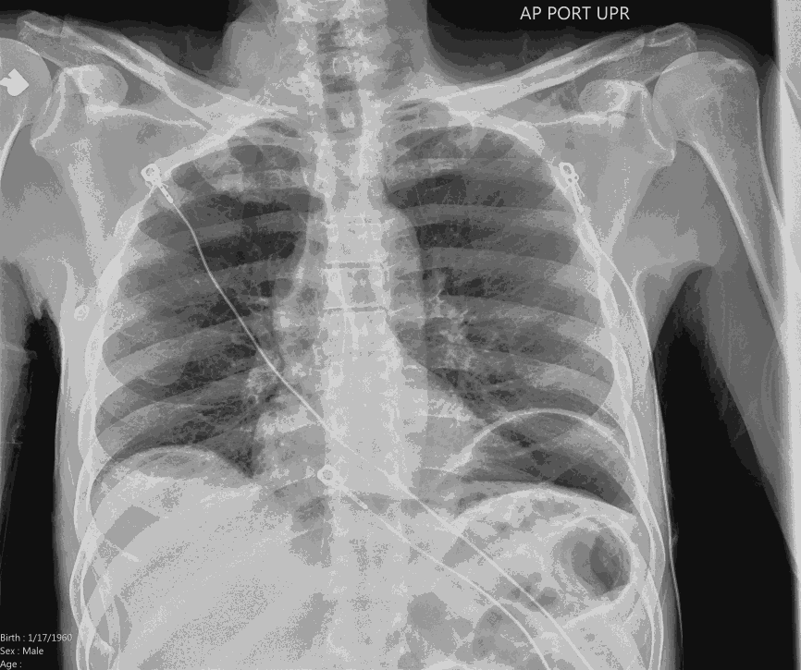
Acute abdominal series

Slide 37
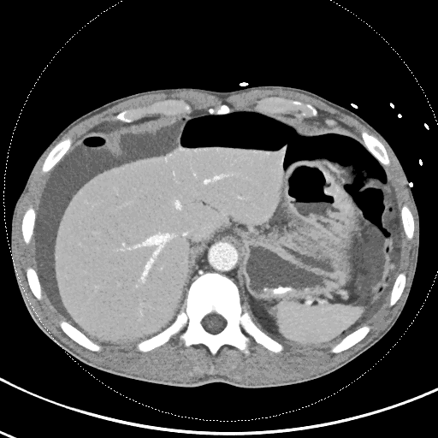
CT axial

Slide 38
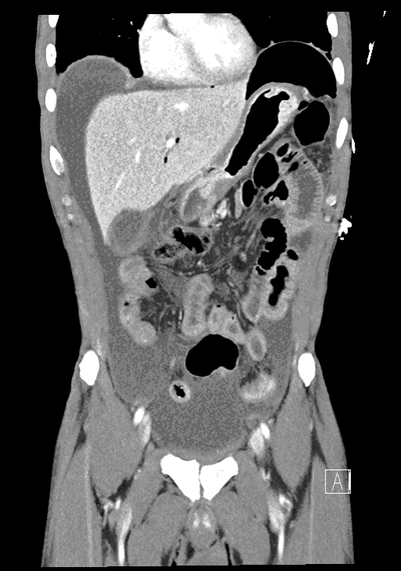
CT coronal

Slide 39
DIAGNOSIS?

Slide 40
Perforated pyloric ulcer
Imaging findings:
  Pneumoperitoneum, typically larger volume than for bowel perforation
  May see focal discontinuity in gastric/duodenal wall
  Hx of gastric/duodenal ulcer often very helpful
Consider benign causes: postoperative, G-tube placement, barotrauma
Often, exact etiology must be determined surgically plus history and imaging

Slide 41
CASE 6
60 year old male with recent partial bowel resection now presenting with fever and tachycardia.
On exam, mild tenderness in the left lower quadrant
T 100.2, HR 120, WBC 18

Slide 42
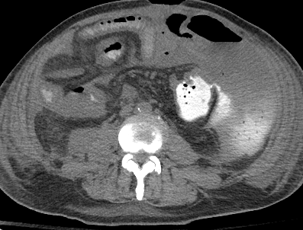
CT axial

Slide 43
DIAGNOSIS?

Slide 44
Anastomotic leak
Imaging findings:
  Fluoroscopic enema – can be used for distal anastomoses in colon
  CT with positive oral contrast – look for contrast spilling outside the lumen at the site of anastomosis (must wait long enough to allow contrast to opacify the anastomosis)
Management
  Serious postoperative complication, typically in the immediate (days to weeks) postoperative period
  Sometimes managed expectantly with drain placement and ABX but may require surgical intervention

Slide 45
CASE 7
80 year old female with history of atrial fibrillation presents with diffuse abdominal pain and small volume bloody stool.
On exam, diffuse abdominal tenderness, altered mental status
WBC 25, lactic acid 5

Slide 46
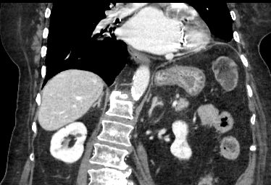
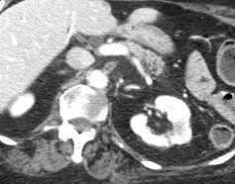

Slide 47
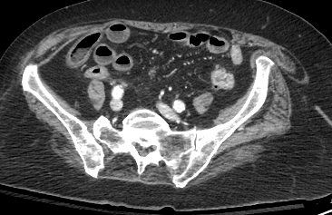

Slide 48
DIAGNOSIS?

Slide 49
Left atrial thrombus with acute mesenteric ischemia
Imaging findings
  Acute – occlusion of major abdominal branch vessel (SMA, IMA) with resultant hypoperfusion of bowel (featureless, hypoenhancing). Can also see pneumatosis, portal venous gas
  Chronic – more difficult imaging diagnosis, typically have advanced atherosclerotic disease involving mesenteric vessels. Typically don’t see changes in bowel wall, as this is usually episodic after eating
Clinical features
  Classic presentation is pain out of proportion to exam, often with elevated lactic acid
  If acute, mesenteric ischemia has a high mortality rate and typically requires resection of necrotic bowel as well as possible thrombolysis/thrombectomy
  If chronic, typically manage risk factors conservatively. Sometimes stenting or other revascularization is attemped.

