Slide 1
Emergency medicine
Abdominal Radiology Subsection

Slide 2
Acute Abdomen
Acute onset of abdominal pain with rebound, guarding, rigid abdomen
May have fever, leukocytosis, anemia depending on underlying cause
Many possible underlying causes: appendicitis, diverticulitis, perforated hollow viscus, cholecystitis, etc.
How to work up?
  Start with acute abdominal series radiographs
  Includes CXR, upright abdominal XR, supine abdominal XR

Slide 3
Acute abdominal series includes CXR and upright abdominal XR, which improves detection of free air

Slide 4
Next step…CT
CT abdomen/pelvis provides great anatomic detail, can visualize all abdominal organs and identify etiology
But which CT to order??

Slide 5
Ordering CT
With vs. without contrast
  Contrast almost always helpful in the abdomen due to many closely apposed structures. If renal function is OK and no allergy to iodine, likely should order with contrast
  EXCEPTION is when looking for renal stones. CT stone study = CT abdomen/pelvis without contrast
WITH
WITHOUT

Slide 6
Options for CT with contrast
Standard single-phase CT abdomen/pelvis with contrast
  Portal venous phase (70-80 seconds)
  Good for acute abdominal pain, many cancers, infection, bowel obstruction

Slide 7
Bowel ischemia/GI bleeding protocol
1. Noncontrast
2. Arterial phase
3. Portal venous

Slide 8
AAA/aortic dissection protocol (can include chest)
1. Noncontrast
2. Arterial
3. 5 min delay

Slide 9
Trauma protocol
1. Portal venous
2. Nephrographic (2 min delay)

Slide 10
For RUQ pain…
Can go straight to RUQ US if cholecystitis is suspected; however, CT alone can often make the diagnosis and may be a higher yield test if there is any ambiguity about the patient’s symptoms/diagnosis
For pelvic pain in female…
Pelvic US (transabdominal and transvaginal) more sensitive for pelvic pathology, i.e. ovarian torsion, ovarian cyst, ectopic pregnancy, etc.
CT of limited value and is high radiation to young female patient

Slide 11
Case 1
34 year old female with history of depression, alcohol abuse, peptic and duodenal ulcer disease, and hypertension presents to the ED with nausea, vomiting, and abdominal pain.
On examination, she has generalized abdominal pain, particularly in the epigastric region.
Lipase elevated to 438. AST 127. ALT 63. Alk phos 127.

Slide 12
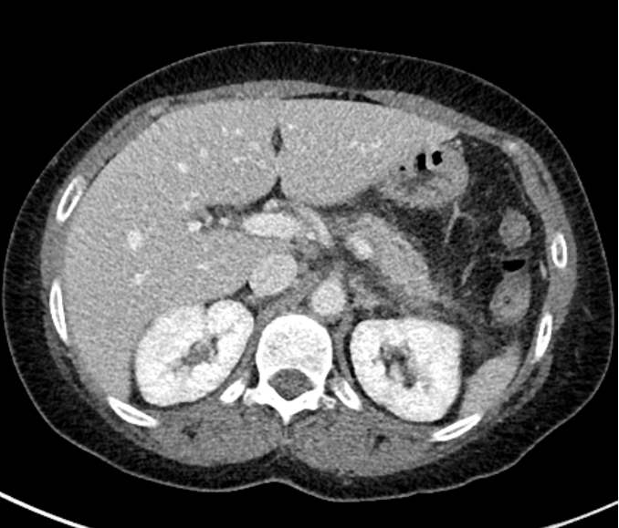
CT Axial

Slide 13
Diagnosis?

Slide 14
Acute interstitial pancreatitis
Imaging findings
  CT: Enlarged with loss of normal fatty lobulation, peripancreatic fat stranding and edema, development of free fluid.
  US: The pancreas is often difficult to evaluate on US in adults, due to shadowing from surrounding bowel loops.
Complications
  Necrotizing pancreatitis: loss of normal enhancement of the pancreatic tissue. Often may not be present initially
  Infected pancreatic necrosis: findings of gas in the pancreatic bed in the setting of necrotic pancreatitis. Poor prognosis
  Vascular pseudoaneurysm: Small contrast-filled outpouching arising from neighboring arteries (splenic, gastroduodenal, pancreaticoduodenal) and hemorrhage.
  Venous thrombosis: Most often involves the splenic vein, may also involve SMV and portal veins.
  Fluid collections: acute peripancreatic fluid collection, acute necrotic fluid collection, pseudocyst, walled-off necrosis

Slide 15
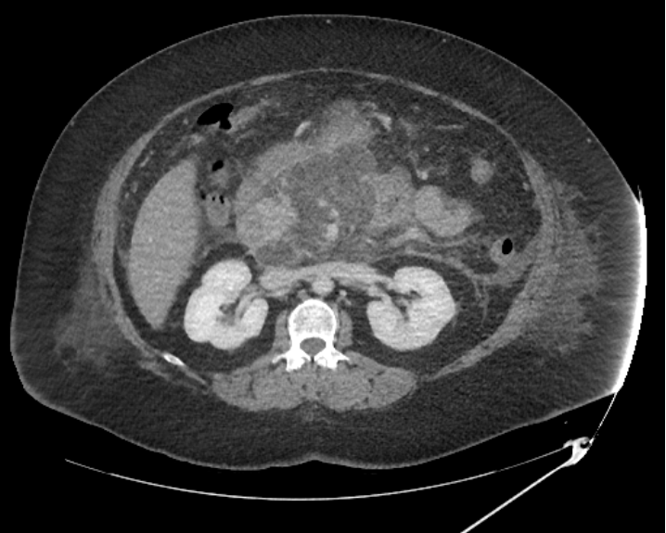
Acute necrotizing pancreatitis

Slide 16
Case 2
53 year old female with no relevant PMH presents with left flank pain, nausea, and vomiting.
She endorses frank hematuria.
Labs: large blood on urinalysis.

Slide 17
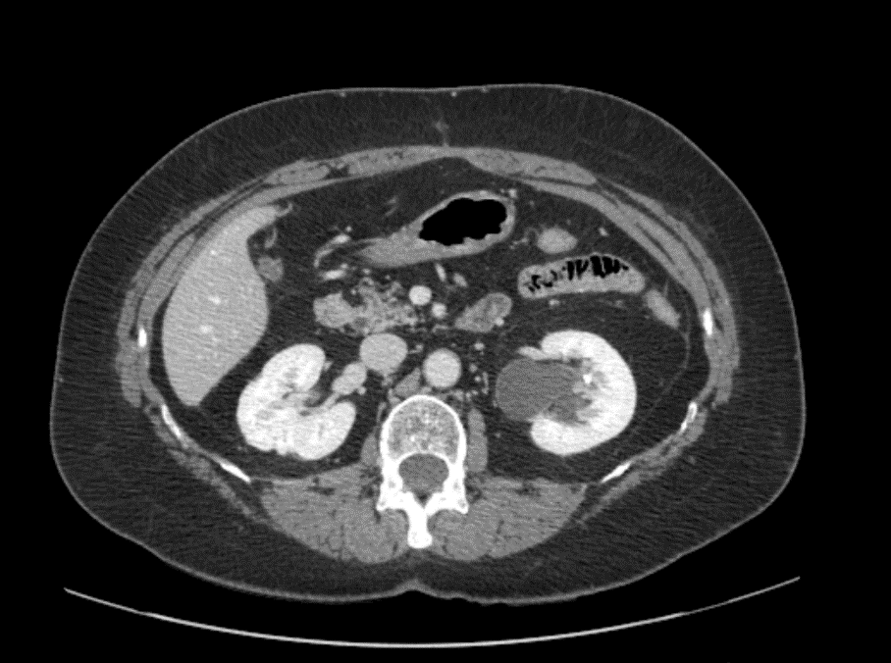
CT axial

Slide 18
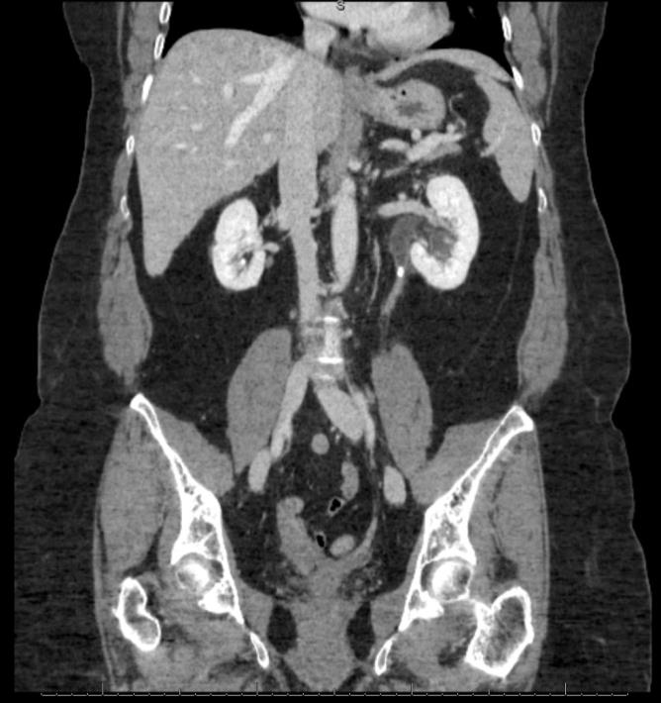
Ct coronal

Slide 19
Diagnosis?

Slide 20
Obstructing ureteral calculus
Imaging findings
  US: Renal stones are echogenic lesions with “twinkle” artifact and shadowing. With obstruction, there is proximal hydroureteronephrosis.
  CT: Calcium stones are hyperdense, with attenuation at 400-600 HU. Uric acid and cystine stones are less dense, with attenuation at 100-300 HU. Other stones may be soft tissue density (matrix and Indinavir stones). As with US, when there is obstruction, there is usually hydroureteronephrosis.
  Radiography: poor sensitivity for stones

Slide 21
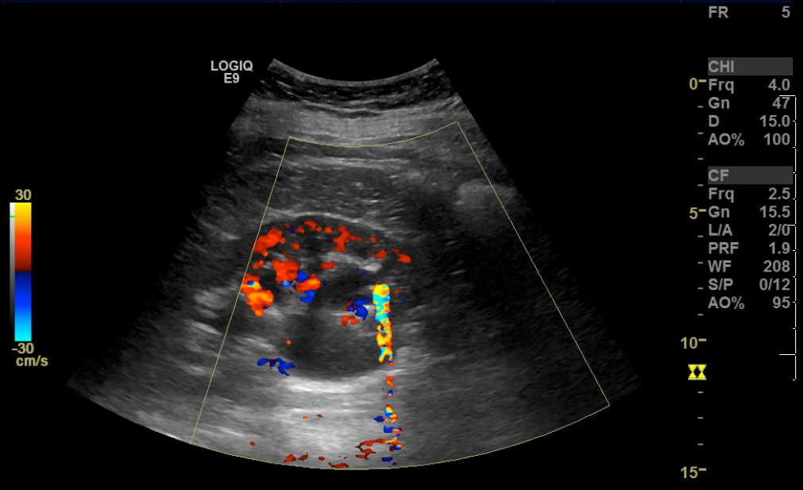
Renal US

Slide 22
Case 3
41 year old female without significant PMH presents to the ED with abdominal, nausea, vomiting, and low back pain.
On examination, she had mild epigastric tenderness. Otherwise, unremarkable examination.
Labs: Moderate leukocyte and positive nitrite on urinalysis, leukocytosis to 14.1

Slide 23
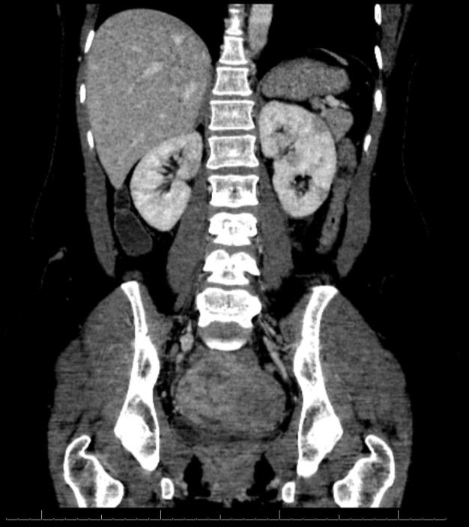
CT coronal

Slide 24
Diagnosis?

Slide 25
Acute pyelonephritis
Imaging findings
  CT: Swelling and enlargement of the kidney, wedge-shaped or rounded areas of hypoenhancement (striated nephrogram), perinephric stranding and edema
Complications
  Renal and perirenal abscess
  Renal scarring and decreased renal function
Differential consideration:
  Renal infarction, lymphoma, and vasculitis can mimic imaging findings of pyelonephritis, with wedge shaped areas of decreased enhancement
  This diagnosis is usually clinical in combination with clinical presentation and laboratory results.

Slide 26
CASE 4
30 year old male with episodic flare of acute abdominal pain and BRBPR
Abdominal tenderness and guarding on exam
Leukocytosis; labs otherwise unremarkable

Slide 27
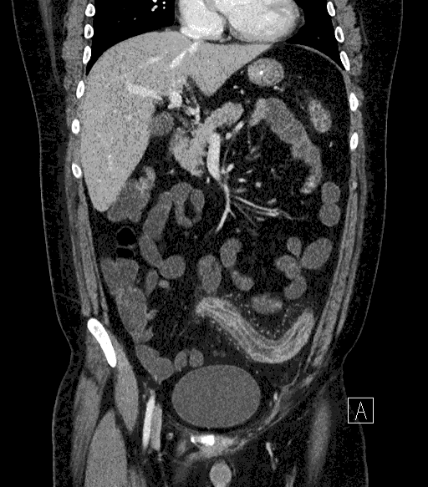
CT CORONAL

Slide 28
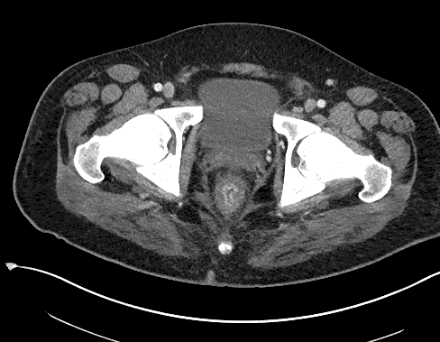
CT AXIAL

Slide 29
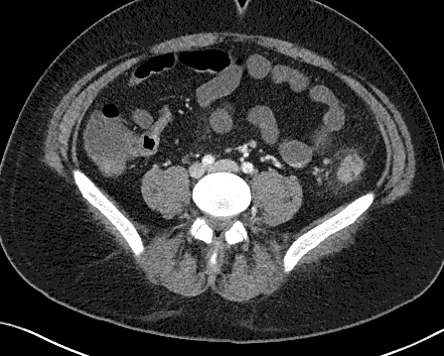
CT AXIAL 2

Slide 30
DIAGNOSIS?

Slide 31
ULCERATIVE COLITIS
Imaging findings
  Pancolitis classically involving the rectum (vs ischemic colitis)
  Terminal ileum typically not involved (vs Crohn’s disease)
  Can progress to toxic megacolon (dilated colon, pneumatosis)
  “Lead pipe” colon on barium enema
Etiology and Demographic
  Idiopathic, but often associated with primary sclerosing cholangitis, ankylosing spondylitis, RA
  Bimodal peak (15-40 and 55-65)
  Increased risk of colon CA, will often have PPx colectomy

Slide 32
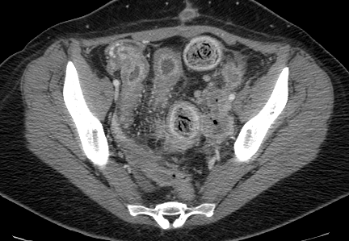
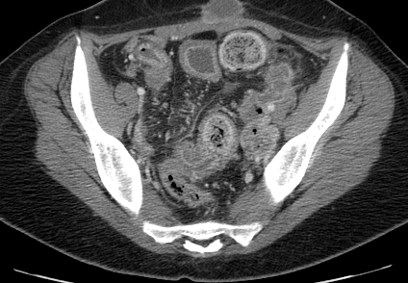
Companion case – Crohn’s

Slide 33
CASE 5
17 year old male involved in an MVA
Complaining of abdominal pain and flank pain
Diminished urine output

Slide 34
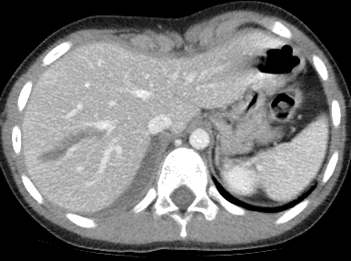
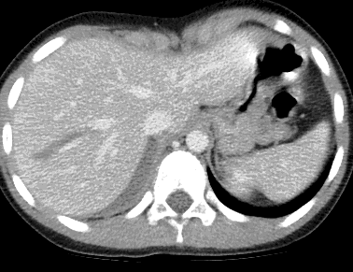
CT AXIAL
Portal venous
Delayed

Slide 35
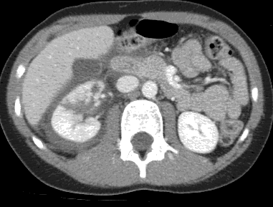
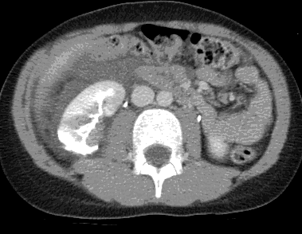
CT AXIAL 2
Portal venous
Delayed

Slide 36
DIAGNOSIS?

Slide 37
TRAUMATIC SOLID ORGAN INJURY
Imaging findings:
  Hypodensities in liver, kidneys, spleen which do not fill in on delayed imaging
  Subcapsular hematoma
  Free fluid in pelvis
  Injury to renal collecting system/pelvis with urine extravasation/urinoma

Slide 38
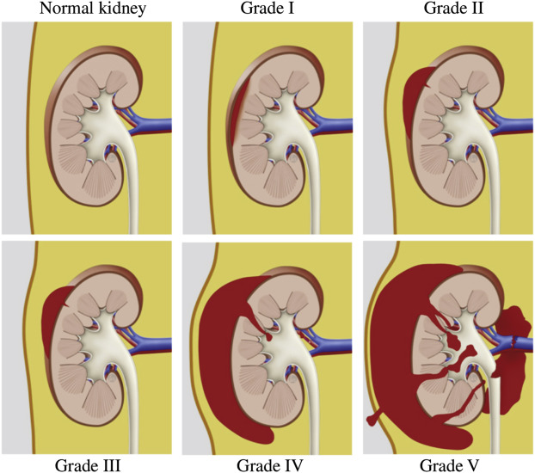
Anselmo da Costa et al. Contemporary management of acute kidney trauma. Journal of Acute Disease 2016 5(1): 29-36.

Slide 39
CASE 6
84 year old female with LLQ pain, BRBPR
Guarding and rebound tenderness in the LLQ on exam
Mild leukocytosis; labs otherwise unremarkable

Slide 40
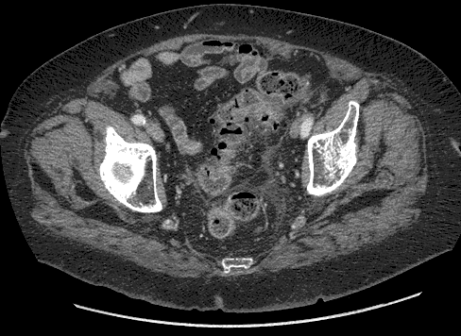
CT AXIAL

Slide 41
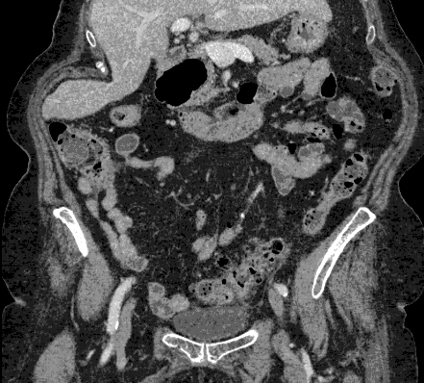
CT CORONAL

Slide 42
DIAGNOSIS?

Slide 43
DIVERTICULITIS
Imaging findings:
  First must see diverticulosis, outpouchings from colonic wall, antimesenteric side. If no diverticula are seen, consider alternate diagnosis!
  Mucosal thickening, hyperenhancement, surrounding fat stranding and thickening of peritoneal lining. Typically in sigmoid colon.
  Look for perforation, abscess
Etiology and demographic
  Typically older patients, low fiber diet, obesity
  Can be difficult to distinguish from colon CA. If recurrent or marked wall thickening or adenopathy, recommend colonoscopy after resolution.
Treatment: ABX, IVF, bowel rest. Consider surgical resection if recurrent.

Slide 44
CASE 7
28 year old female with acute onset LLQ pain
Pelvic exam reveals tenderness in the left adnexal region
Pregnancy test negative

Slide 45
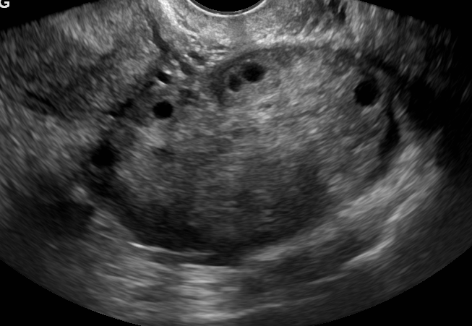
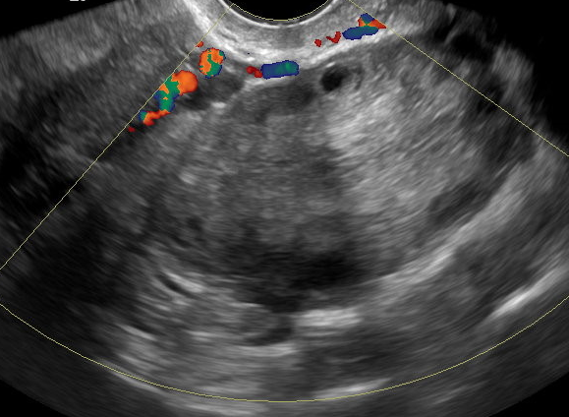
US – L ovary

Slide 46
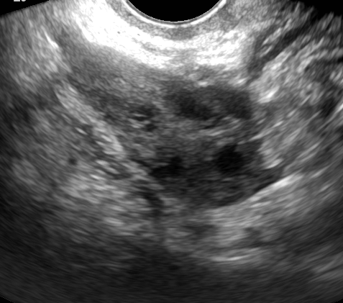
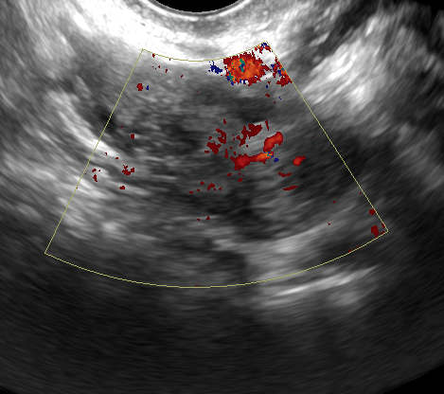
US – R ovary for comparison

Slide 47
DIAGNOSIS?

Slide 48
Ovarian torsion
Imaging findings
  US: best imaging test, involved ovary will be enlarged (edematous) with follicles displaced peripherally
  Doppler may demonstrate lack of blood flow and swirling of adnexal vessels
  CT: not as sensitive, but ovary may be enlarged and positioned more medially than is typical
Management
  Surgical emergency due to risk for infarction
  Can be primary (idiopathic due to laxity of adnexal structures) or secondary to an ovarian lesion that acts as a lead point

